Slide 1
Vocabulary Instruction
Jennifer Whorrall
Literacy Coach
Commonwealth Center for Children and Adolescents

Slide 2
Vocabulary: The Gap
Hart and Risley, 1995
30 Million Word Gap

Slide 3
Lasting Impact
After the initial 1995 study, Hart and Risley were able to recruit 29 of the original 42 families to study the children’s performance in 3rd grade:
Rate of vocabulary growth at age 3 was strongly associated with vocabulary scores at age 9-10
Vocabulary use at age 3 was strongly associated with measures of language skill at 9-10 years old
(Hart & Risley, 2003).

Slide 4
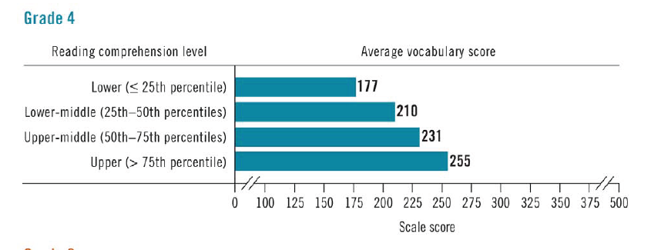
Vocabulary and Reading Comprehension
Latest NAEP vocabulary scores suggest
Vocabulary knowledge is related to reading comprehension

Slide 5
Vocabulary Instruction
Wide/Extensive independent reading and rich discussion
Direct Word Instruction
Generative
Word-specific
Word Consciousness (word play activities)

Slide 6
Kindergarten – First Grade
Most vocabulary instruction is done through shared readings and rich discussion
Oral language and vocabulary are continuing to develop and are closely related to later reading ability
Types of activities
Word sorts – picture sorts into categories
Discussion of synonyms and antonyms
Rich discussion of vocabulary during shared reading and read aloud activities

Slide 11
2nd – 5th Grade
Direct word instruction
Vocabulary across the content areas
Common SOLs
Vocabulary includes:
Homophones
Affixes
Roots
Synonyms/antonyms

Slide 12
Direct Word Instruction
Generative Vocabulary: teaching how words work
Why is this important?
Over 60% of English vocabulary is created through a combo of Latin and Greek roots, prefixes, and suffixes
Over 90% of vocabulary in science and technology is created from the combo of Latin and Greek roots, prefixes, and suffixes
90% of English words with more than 1 syllable are Latin based (most of the remaining 10% are Greek based)
Morphological knowledge makes a significant contribution to reading ability and is correlated with reading ability through high school
(Flanigan, Hayes, Templeton, Bear, Invernizzi, & Johnston, 2011)

Slide 13
Generative Vocabulary
Activities
Word play
Graphic Organizers
Transcends across content areas (science, math, technology, social studies) – make connections

Slide 16
Word Specific Instruction
3 tiers
Tier 1: conversational vocabulary
90% of written texts are comprised of words from Tier 1
Tier 2: core academic words
Words that are encountered across content
Tier 3: content-specific words
Distinctive to content area (concepts) – take longer to teach and learn

Slide 17
Word Specific Instruction
Selection of words
Three-Level Framework
Deep Knowledge Words
Important enough to spend significant time teaching
Explicitly teach/guide students to deep understanding
Use in before/during/after reading or teaching
Foot-In-The-Door Words
Can be Content Specific OR Core Academic
Require minimal teaching – brief explanation in rich context
Words NOT to Teach
Words already known
Words that do NOT serve lesson objectives
(Flanigan, Hayes, Templeton, Bear, Invernizzi, & Johnston, 2011)

Slide 18
Word Specific Instruction
Examples:
Semantic Feature Analysis
Semantic Gradient
Semantic Map
Concept Sorts
Concept of Definition Map
Four Square
Frayer Model

Slide 19
Knowledge Rating Chart Prevents teaching known words
Word | Know It Well | Have Seen or Heard It | Have No Clue

Slide 20
Frayer Model

Slide 25
Semantic Map

Slide 26
Semantic Map: Example

Slide 29
Semantic Features Analysis
Concept Terms | Key Features
Directions
After you read the text selection, code what characteristics are associated with which terms.
Codes
+ If the term typically possesses that feature
– If the term does not typically include that characteristic
? If it is debatable or if the key feature depends upon the specific context/situation

Slide 30
SFA Example

Slide 32
Visual Imagery
4 Square
Word Graffiti
Draw-Label-Caption

Slide 33
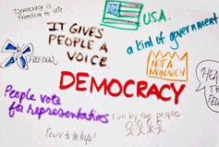
Vocabulary Graffiti
Write the vocabulary word in large letters in the center of the paper
Fill in the paper with words, symbols, and pictures that help to define the vocabulary word/concept
Encourage students to include examples
The entire page should be covered

Slide 36
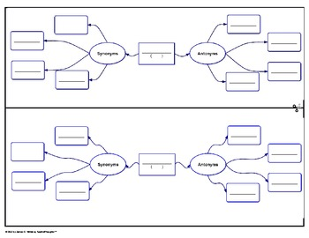
Synonyms and Antonyms

Slide 37
Homophones
Create Homophone or Homograph books

Slide 38
Games

Slide 39
Word Gradient (Continuum)

Slide 40
Hink Pinks

Slide 41
Resources
Florida Center for Reading Research
http://www.fcrr.org/for-educators/sca.asp
Comprehensive Reading Solutions
http://comprehensivereadingsolutions.com/
Word Generation
http://wordgen.serpmedia.org/s_elem.html

